Slide 1
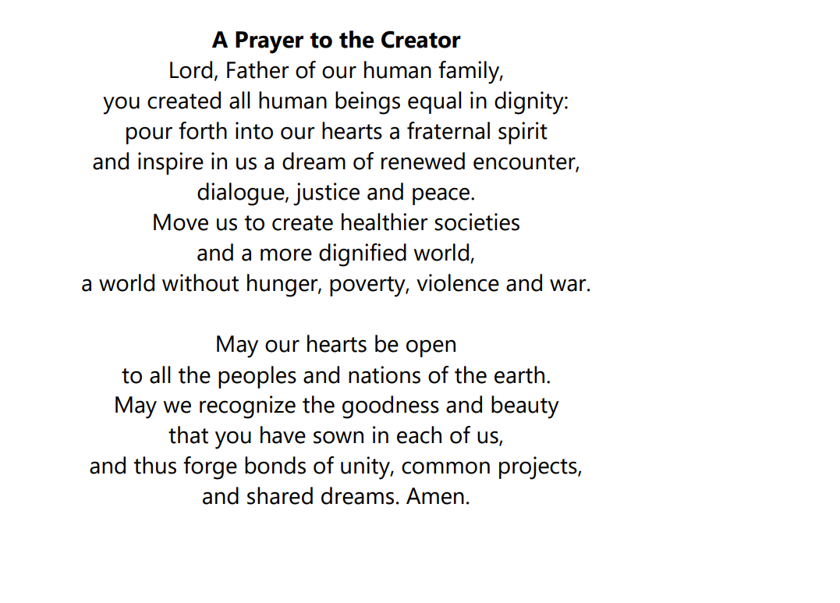

Slide 2
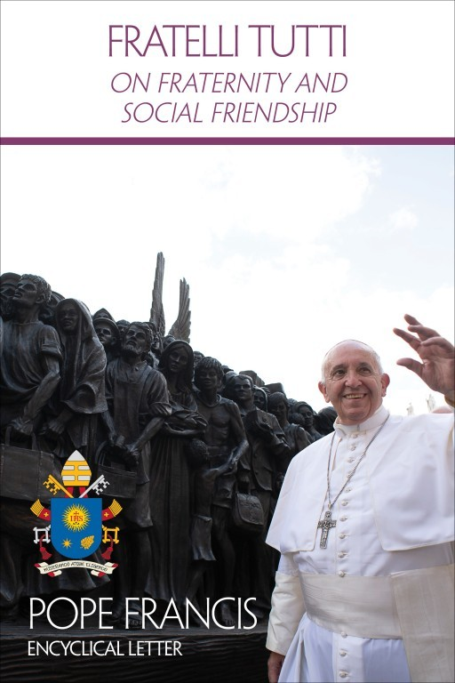

The Theology of the Good Samaritan: Putting Fratelli Tutti into Action
Yohan Garcia, Catholic Social Teaching Education Coordinator
November 11, 2021

Slide 3
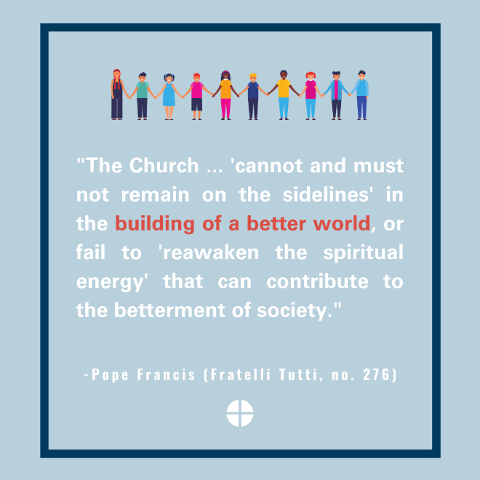
A Call to Fraternity and Social Friendship in a Time of Isolation
Dark Clouds Over a Closed World
A Stranger on the Road
Envisaging and Engendering an Open World
A Heart Open to the World
A Better Kind of Politics
Dialogue and Friendship in Society
Paths of Renewed Encounter
Religions at the Service of Fraternity in our World

Slide 4
See-Judge (Discern)-Act Methodology
Interpret the “signs of the times” (Vat. II, GS)
“illuminate with an unchanging light the new problems that are constantly emerging.” (Caritas in Veritate 12)
Put our faith in action… “Each day we have to decide whether to be good Samaritans or indifferent bystanders” (Fratelli Tutti, No. 69).

Slide 5
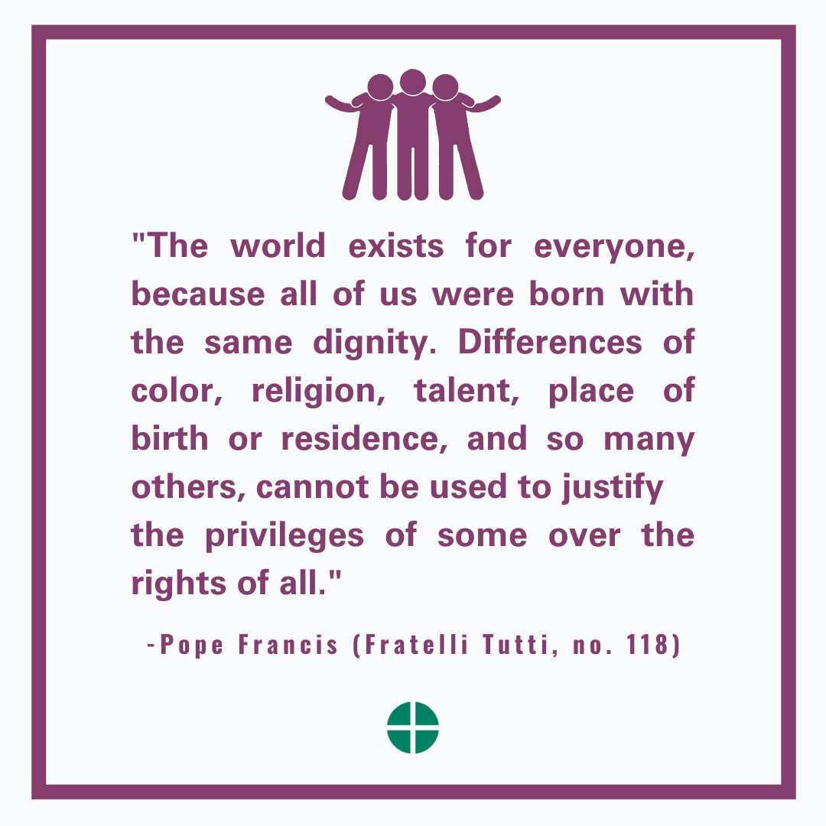
A TIME TO SEE

Slide 6
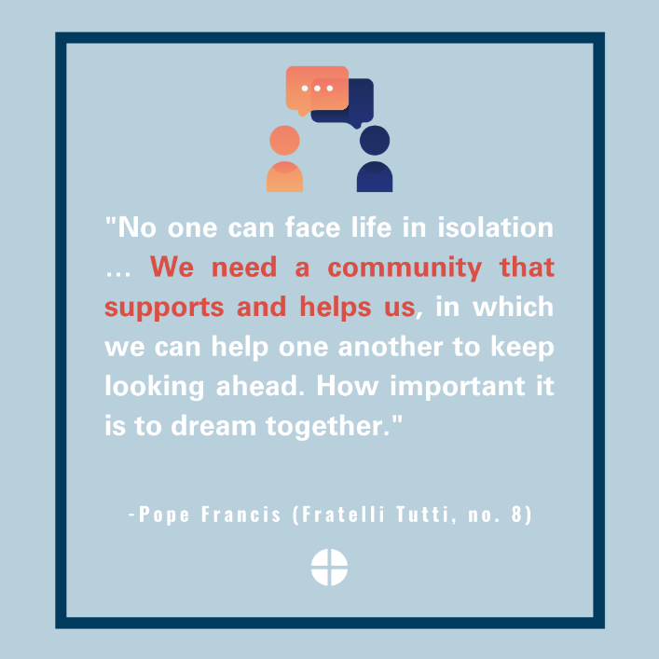
Dark Clouds Over a Closed World
Shattered Dreams
Lacking a Plan for Everyone
Globalization and Progress without a Shared Roadmap
Pandemics and other Calamities in History
An Absence on Human Dignity at the Borders
The Illusion of Communication
Forms of Subjection and of Self-Contempt

Slide 7
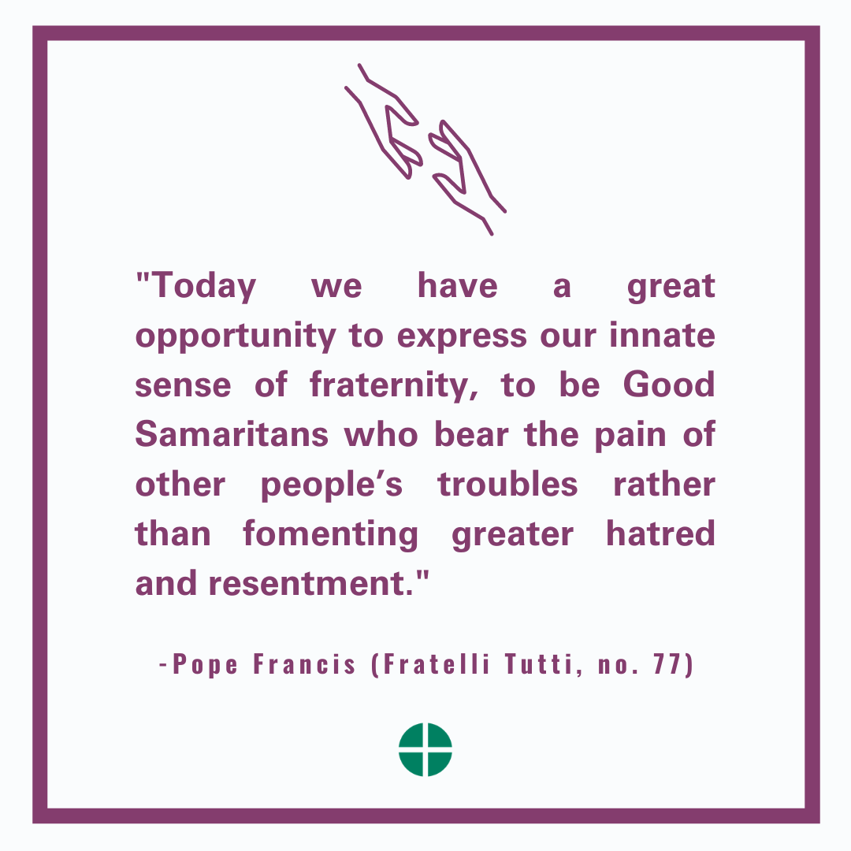
A TIME TO JUDGE (DISCERN)

Slide 8
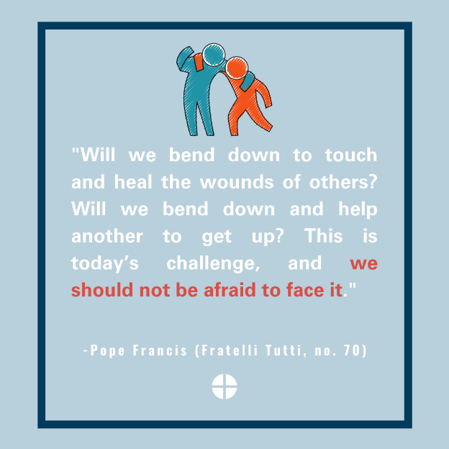
A Call to be Neighbors in the World
How can you love those who may be seen as “the other”? Have you ever felt the sting of being excluded?
Faithful worship of God is not complete without putting that faith into action.
Pope Francis calls us to active participation in our communities. We must take up a “co-responsibility” in creating communities built upon solidarity and social friendship. We all have a role to play in transforming our communities.
In the final words of the parable, Jesus invites us each to “Go and do likewise” (Lk 10:37). As Pope Francis observes, “he challenges us to put aside all differences and, in the face of suffering, to draw near to others with no questions asked” (no. 81).

Slide 9
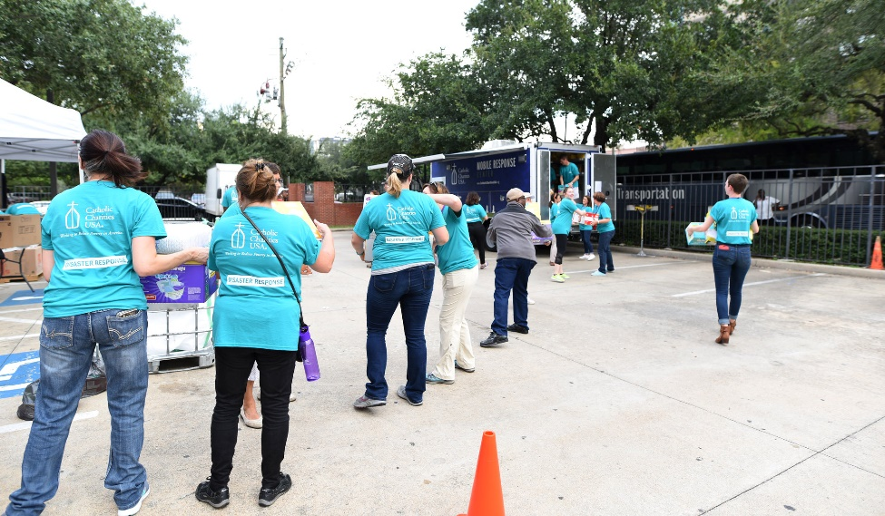

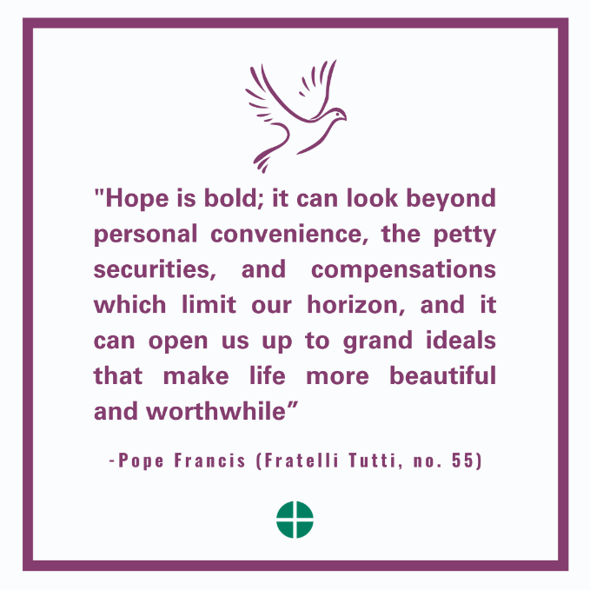
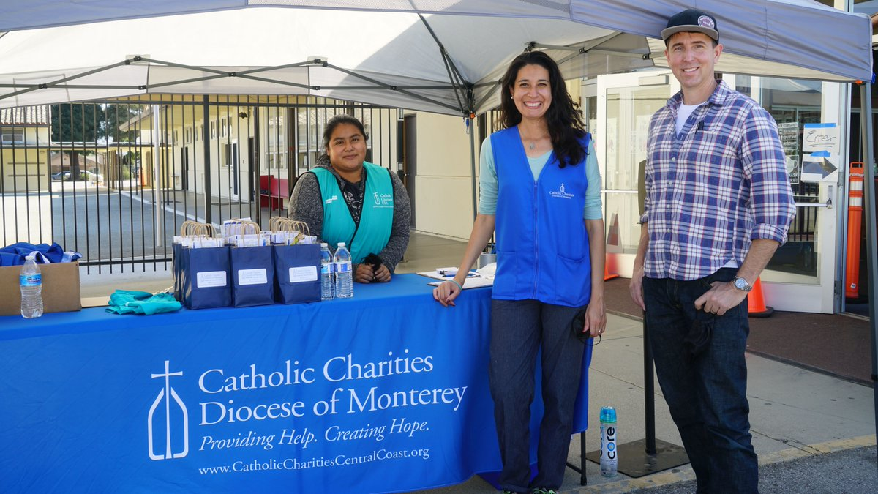
Accompanying with Compassion: The Ministry of CCUSA
Images on the left and logo on the top right: credit to CCUSA

Slide 10
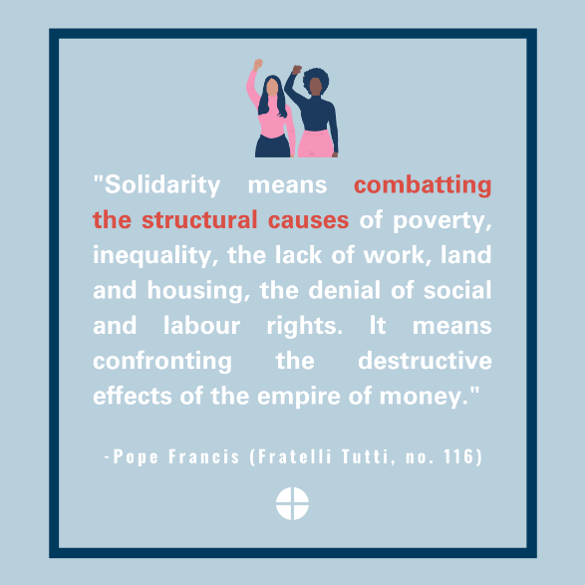
Solidarity as Social Friendship
Pope Francis invites us to foster a heart open to the whole world that allows us to see that our well-being is tied up to that of our neighbors near and far, that “to attain fulfillment in life we need others” (no. 150).
Pope Francis invites us to return to the story of the Good Samaritan and reflect on the role social standing played in each character’s decision about whether or not to help the injured man. The Samaritan was “free of every label and position . . . [and] was able to interrupt his journey, change his plans, and unexpectedly” act as a neighbor to someone in need (no. 101).
In what ways do social and cultural norms impact how you view or think about others?
How can you begin to shift your perspective and act in ways that embrace the “hidden exiles” in your community: victims of racism, those with disabilities, the poor, and the migrant?
Integral human development tells us that survival is not enough, that each human person’s inherent dignity demands that we each have what we need to thrive, no matter our circumstances or talents.

Slide 11
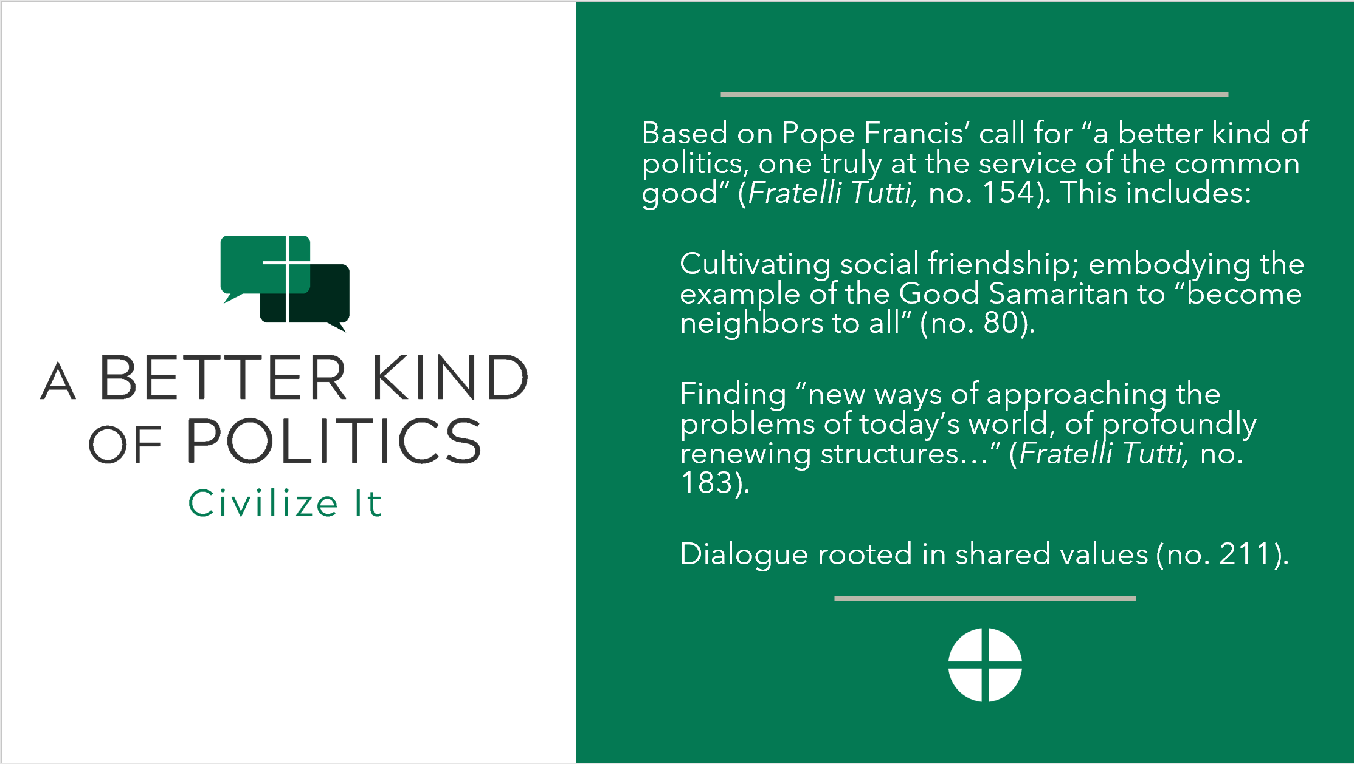
A Better Kind of Politics

Slide 12
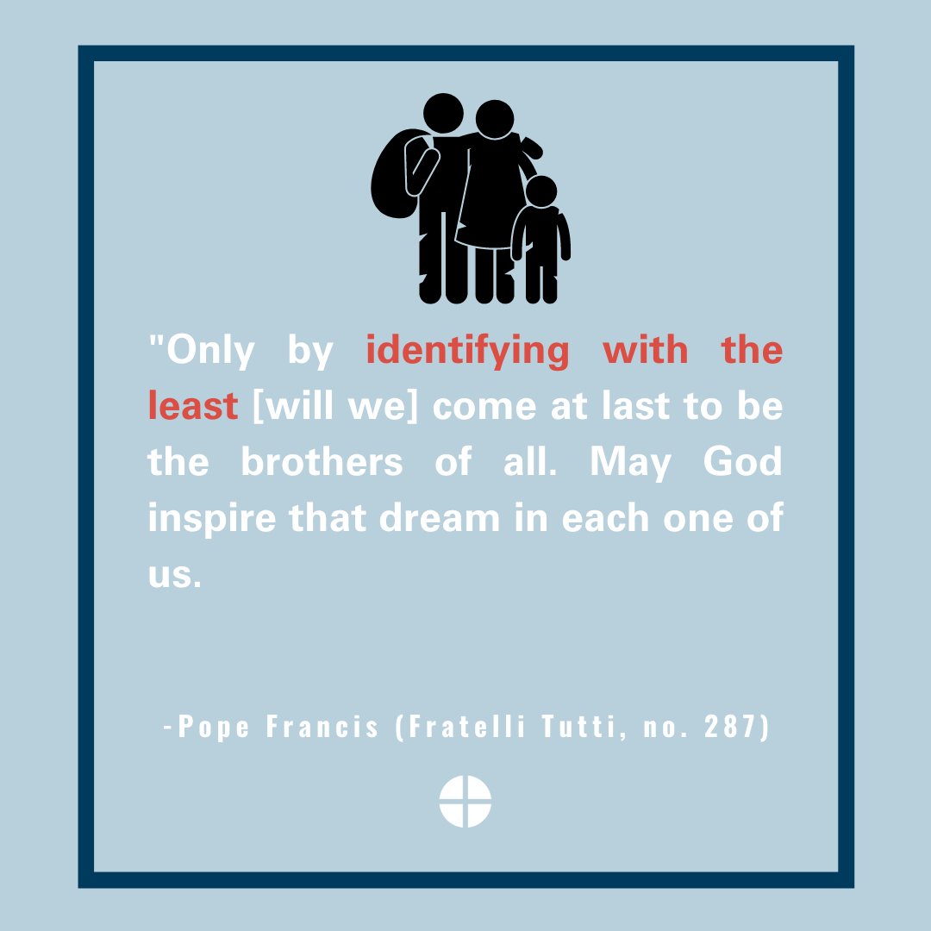
Christians of and for the World

Slide 13
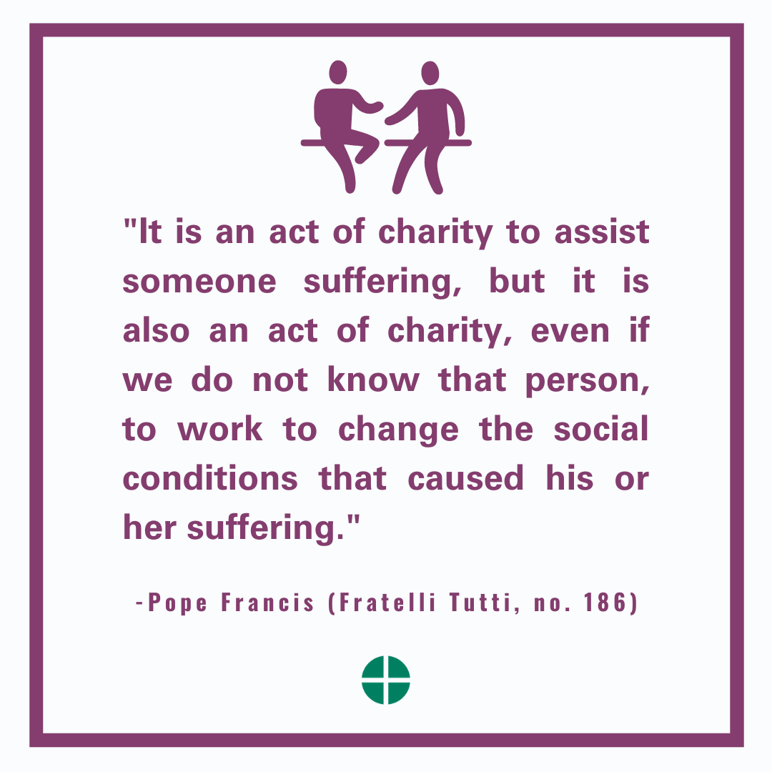
A TIME TO ACT

Slide 14
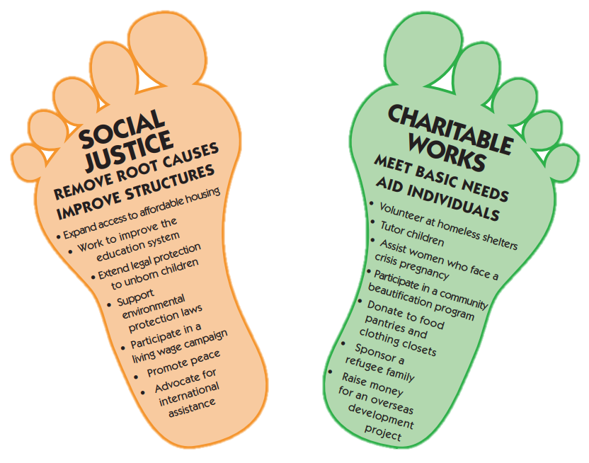
Two Feet of Love in Action

Slide 15
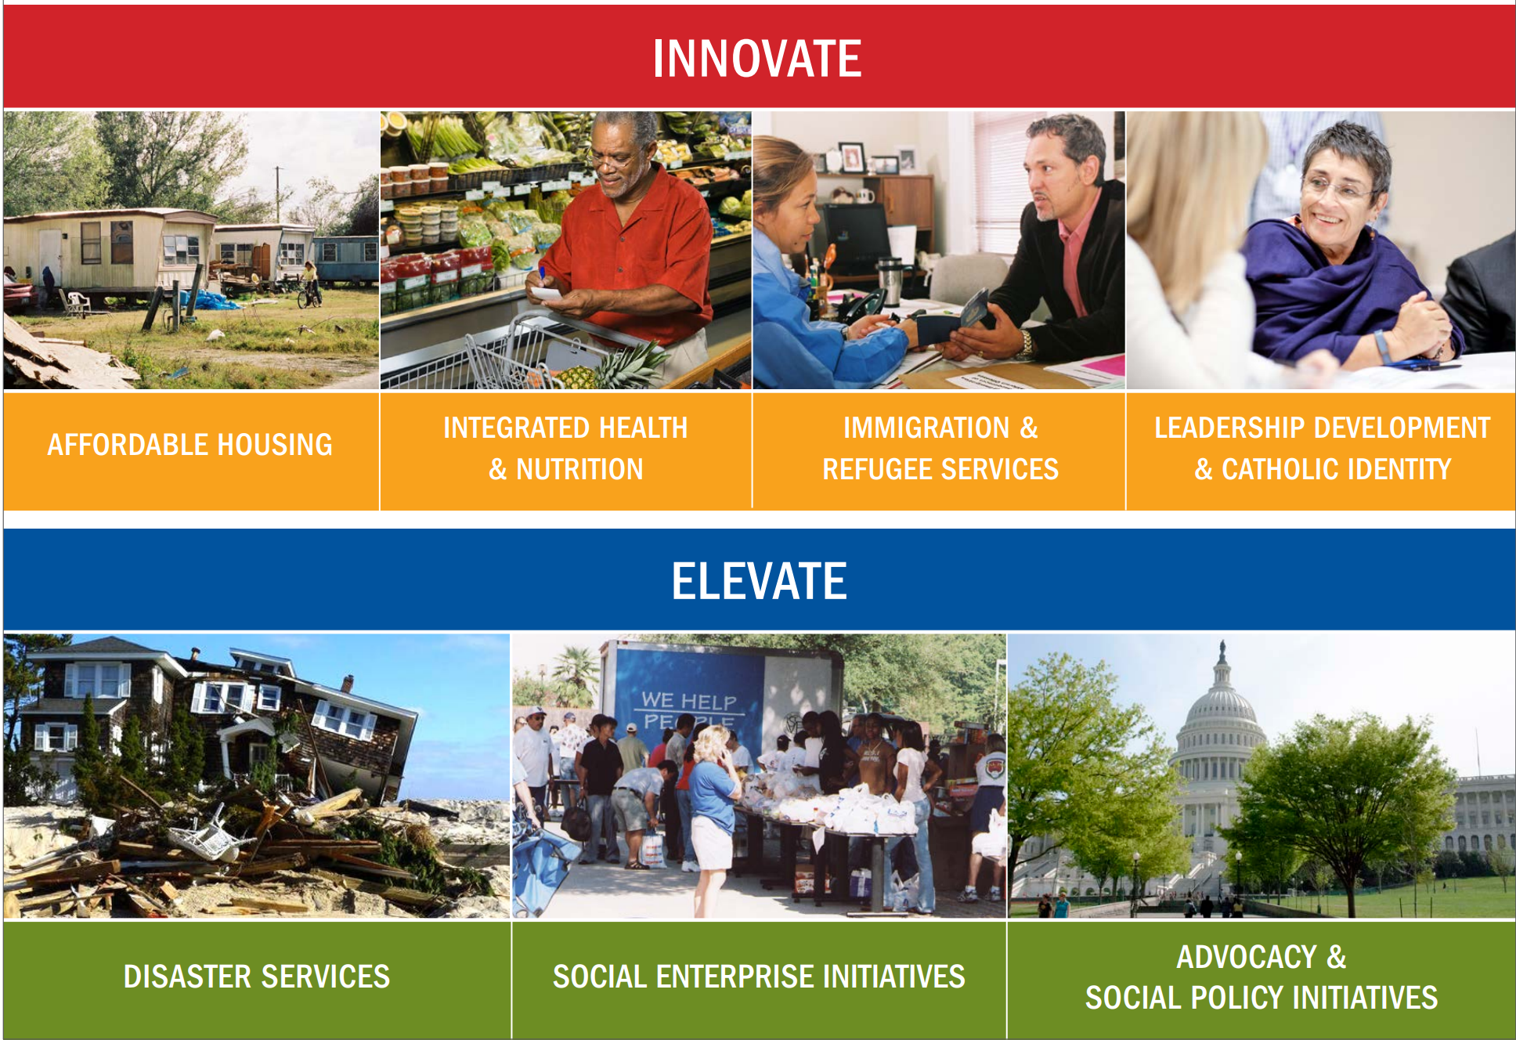
CCUSA Strategic Priorities 2017-2022

Slide 16
Questions for Reflection & Dialogue
In what ways are you living out this call to love your neighbor as yourself?
How have you taken intentional efforts to put your faith into action?
What differences or previously held beliefs do you need to put aside to truly become a neighbor to our brothers and sisters?

Slide 17

Q&A

Slide 18
